Slide 1
MENTAL HEALTH COMPANION CHATBOT
Presented By:
Student Name - Divyadharshini S
College Name - Easwari Engineering College
Department - BE - Computer Science and Engineering

Slide 2
OUTLINE
Problem Statement
Proposed System/Solution
System Development Approach
Algorithm & Deployment
Result
Conclusion
Future Scope
References

Slide 3
Problem Statement
In recent years, students have been experiencing increased levels of stress, anxiety, depression, and emotional burnout due to academic pressure, competitive environments, career uncertainty, and social challenges. While mental health support is essential, many students hesitate to seek professional counseling because of stigma, lack of awareness, high costs, or limited access to mental health professionals. As a result, emotional struggles often remain unaddressed, negatively affecting students’ academic performance, personal well-being, and confidence. There is a strong need for a safe, private, and easily accessible digital support system that allows students to express their emotions freely. An AI-powered mental health chatbot can help bridge this gap by detecting mood through sentiment analysis, providing empathetic responses, and offering basic relaxation and wellness guidance anytime and anywhere.

Slide 4
Proposed SYSTEM/Solution
The proposed system is an AI-powered Mental Health Companion Chatbot designed to support students’ emotional well-being in a safe, private, and accessible manner. The system allows students to freely express their thoughts and feelings through a chat-based interface. Using Natural Language Processing (NLP) and sentiment analysis, the chatbot identifies the user’s emotional state (positive, neutral, or negative). Based on the detected mood, a Large Language Model (LLM) generates empathetic, supportive, and motivational responses. The system also provides guided breathing exercises, daily affirmations, wellness tips, and mood tracking features to help users manage stress effectively. Built using Python and Streamlit, the application is lightweight, user-friendly, and available anytime, making it a practical mental health support tool for students.

Slide 5
System DEVELOPMENT Approach
User Interface Layer
Streamlit-based web interface for student interaction
Allows users to type thoughts, emotions, and concerns
Displays chatbot responses, affirmations, and wellness tips
Designed with a calm and user-friendly layout
Input Processing Layer
Receives user text input
Cleans and prepares text for analysis
Converts raw input into a format suitable for NLP processing
Purpose:
To ensure smooth, safe, and intuitive communication between the user and the system.

Slide 6
System DEVELOPMENT Approach
Mood Detection (NLP Layer)
Uses sentiment analysis to detect emotional state
Classifies mood as Positive, Neutral, or Negative
AI Response Generation (LLM Layer)
Uses a Large Language Model (LLM)
Generates empathetic, supportive, and context-aware responses
Response tone dynamically adapts based on detected mood
Purpose:
To understand user emotions and deliver personalized, emotionally appropriate support.

Slide 7
System DEVELOPMENT Approach
Wellness Support Layer
Provides breathing exercises, affirmations, and stress-relief tips
Helps users manage anxiety and emotional distress
Session & Data Management Layer
Tracks mood history and session state
Maintains conversation continuity
Ensures minimal and secure data handling
Deployment & Security Layer
Deployed as a web application using Streamlit
API keys protected using environment variables
Ensures user privacy and data safety
Purpose:
To support long-term mental well-being with a secure and scalable system.

Slide 8
Algorithm & Deployment
ALGORITHM:
User enters a message expressing thoughts, emotions, or concerns through the chat interface.
Input text is preprocessed and validated to ensure clean and meaningful data.
Sentiment analysis is performed using NLP techniques to classify the user’s mood as positive, neutral, or negative.
Detected mood is mapped to emotional states such as calm, stressed, or anxious.
Conversation context is maintained using session memory for personalized responses.
AI prompts are dynamically generated based on detected mood:
  Positive: Motivational and encouraging responses
  Neutral: Reflective and guiding responses
  Negative: Empathetic and calming responses
Groq-powered LLaMA-based Large Language Model processes mood-aware prompts.
AI generates supportive, non-judgmental responses in real time.
Wellness tools like breathing exercises, affirmations, and tips are triggered when needed.
Responses are formatted for clear frontend display.
User interactions and mood history are stored securely for insights and streak tracking.

Slide 9
Algorithm & Deployment
DEPLOYMENT:
Frontend developed using Streamlit, providing a simple, interactive, and responsive web interface.
Application deployed locally and compatible with cloud platforms such as Streamlit Community Cloud.
Backend logic implemented using Python, integrating sentiment analysis and AI response generation.
Groq API used to access high-performance Large Language Models (LLMs) for real-time responses.
Environment variables managed securely using .env files to protect API keys.
Session state used to maintain conversation context and mood streaks without external databases.
Modular code structure ensures easy scalability and feature expansion.
Lightweight architecture enables fast response times suitable for student usage.
CI-ready structure allows future deployment to cloud services like AWS or Azure.
System designed for high availability and low latency to support real-time mental health assistance.

Slide 10
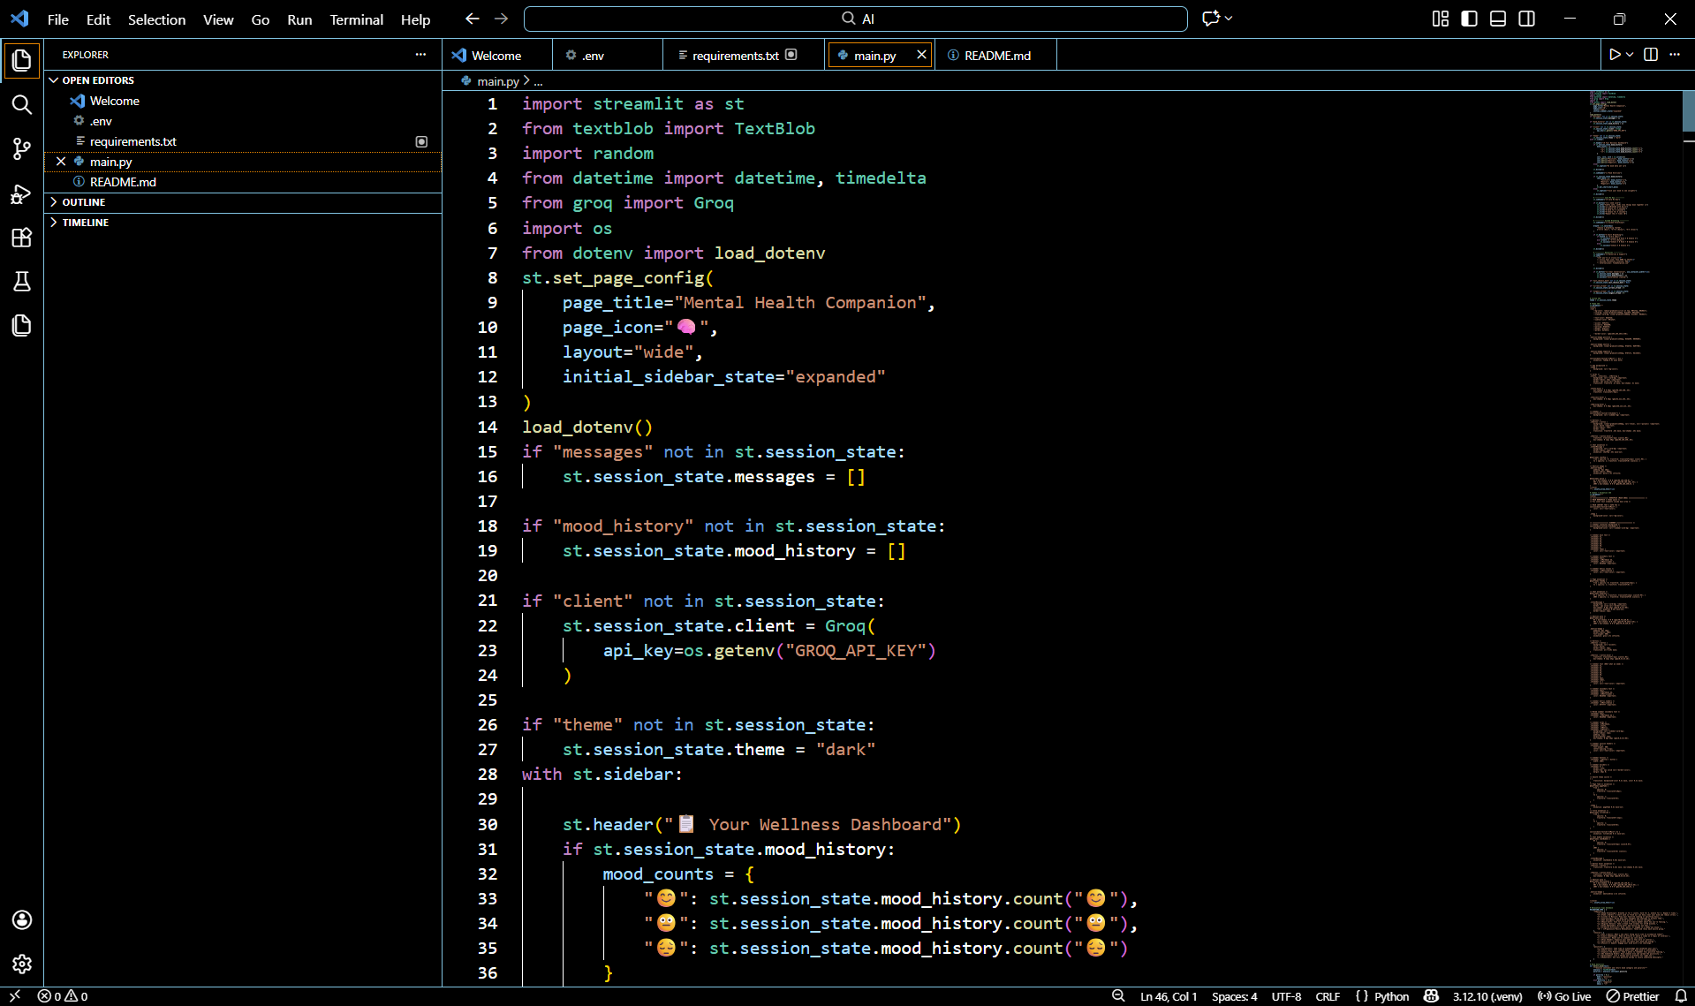
Result

Slide 11
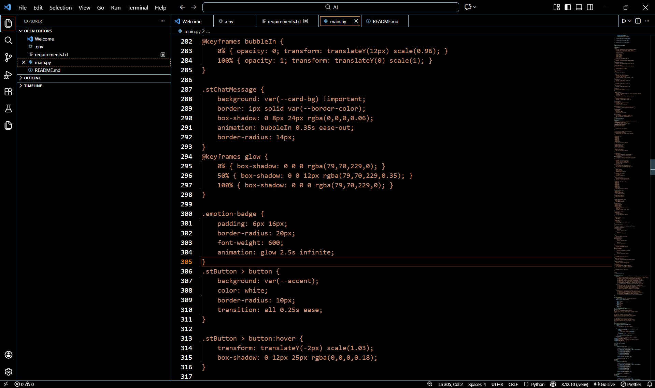
Result

Slide 12
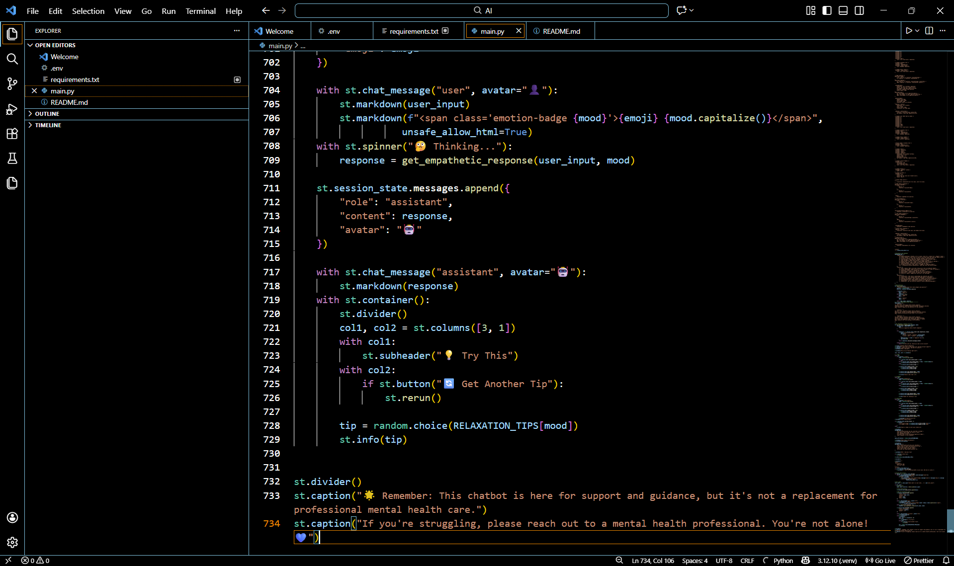
Result

Slide 13
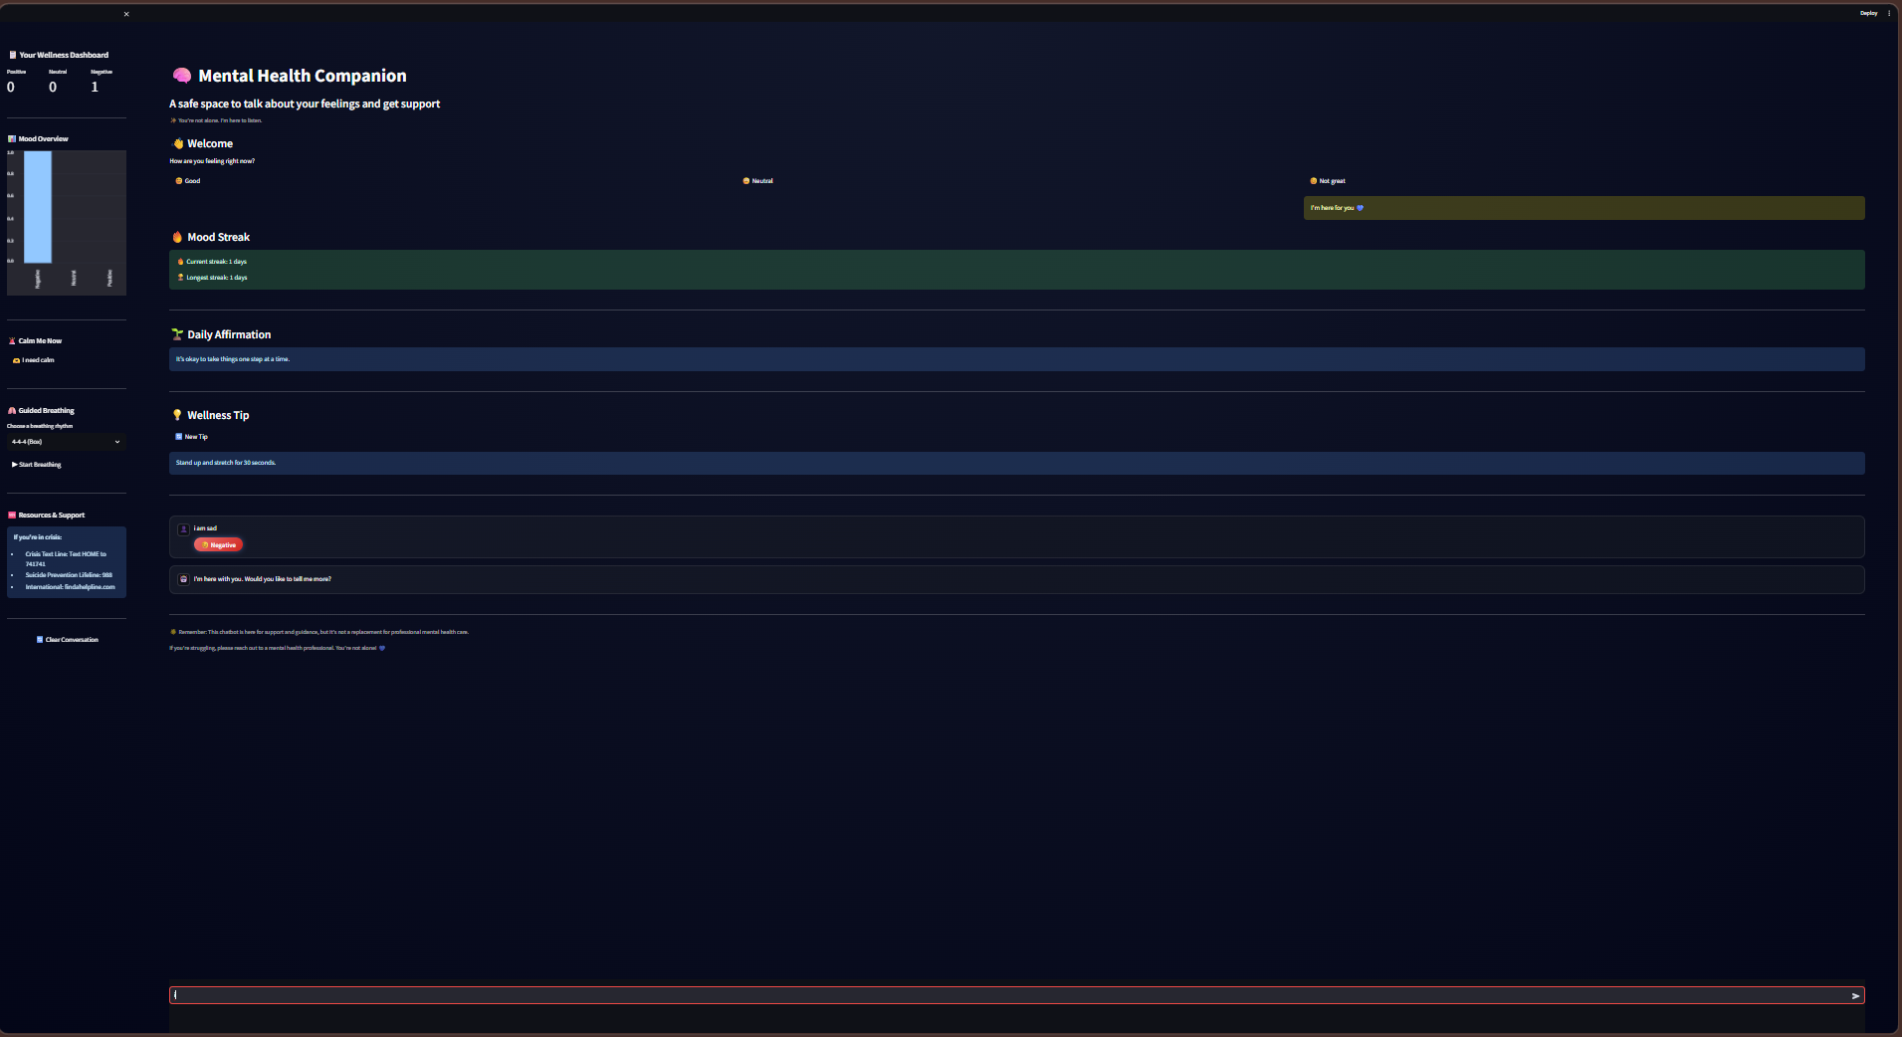
Result

Slide 14
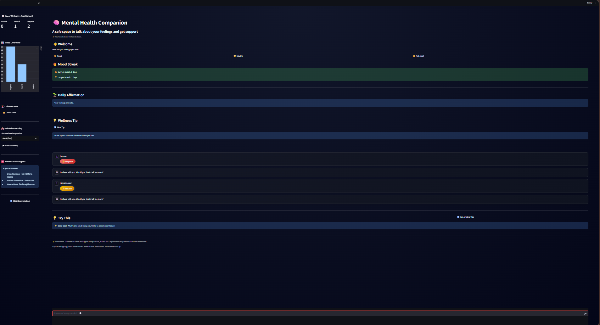
Result

Slide 15
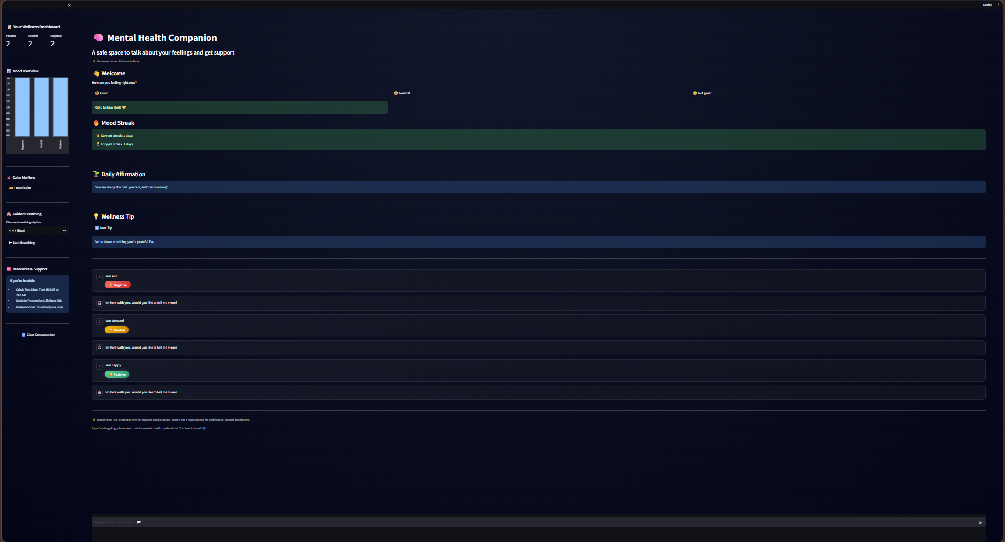
Result

Slide 16
Conclusion
The Mental Health Companion Chatbot for Students successfully demonstrates how AI and Natural Language Processing can be used to support student mental well-being in an accessible and non-judgmental way. By combining sentiment analysis, mood detection, and a Large Language Model, the system provides empathetic, mood-aware responses along with practical wellness tools such as breathing exercises, affirmations, and stress-management tips.
The chatbot offers a safe first point of support for students who may hesitate to seek professional help, helping reduce stress, anxiety, and emotional isolation. Its user-friendly Streamlit interface, real-time interaction, and personalized responses make it both effective and easy to use. While not a replacement for professional mental health care, this project highlights the potential of Generative AI as a supportive companion, promoting awareness, emotional regulation, and healthier coping habits among students.

Slide 17
Future scope
Integrate advanced emotion detection using voice and facial cues.
Enable long-term mood tracking with weekly and monthly insights.
Add multilingual support for wider student accessibility.
Incorporate professional mental health support and emergency helplines.
Develop a mobile application for continuous, on-the-go support.
Enhance AI personalization using adaptive and reinforcement learning.

Slide 18
References
Streamlit Documentation
https://docs.streamlit.io
Groq API Documentation – LLM inference using LLaMA models
https://console.groq.com/docs
Meta LLaMA Large Language Models
https://ai.meta.com/llama/
Visual Studio Code (VS Code)
https://code.visualstudio.com/

Slide 19
Github link:
Github Link : https://github.com/DIVYADHARSHINI-S-16/Mental-Health-Chatbot
Deployment Link: https://mental-health-chatbots.streamlit.app/
API Used (if needed) : 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
In case the Streamlit text is displayed in gray on a laptop, we recommend viewing it on a mobile device,it works well.

Slide 20
THANK YOU

